Slide 1
Immer

Slide 2
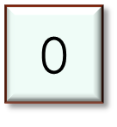
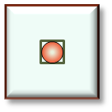
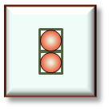
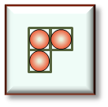
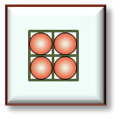
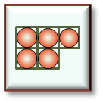
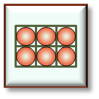

Slide 3


Slide 5


Slide 7


Slide 9


Slide 11


Slide 13


Slide 15


Slide 17


Slide 19


Slide 21


Slide 23


Slide 25


Slide 27


Slide 29


Slide 30


Slide 31


Slide 32


Slide 33


Slide 34


Slide 35


Slide 36


Slide 38


Slide 40


Slide 42


Slide 44


Slide 46


Slide 48


Slide 50


Slide 52


Slide 54


Slide 56


Slide 58


Slide 60


Slide 62


Slide 64


