Slide 2
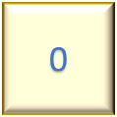
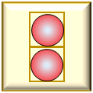
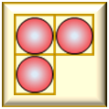
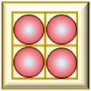

Slide 3


Slide 5


Slide 7


Slide 9


Slide 11


Slide 13


Slide 15


Slide 17


Slide 19


Slide 21


Slide 23


Slide 25


Slide 26


Slide 27


Slide 28


Slide 30


Slide 32


Slide 34


Slide 36


Slide 38


Slide 40


Slide 42


Slide 44


Slide 46


Slide 48


Slide 50


Slide 52


Slide 54
Bravo!

Slide 55
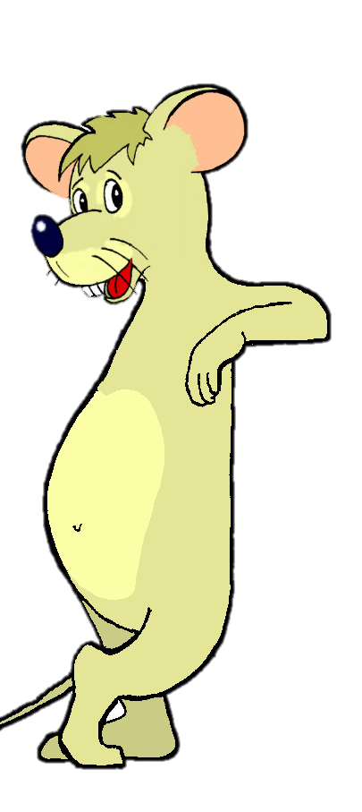
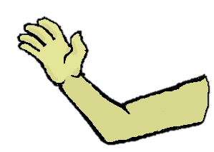
0

Slide 56
0

Slide 57
0

Slide 58
0

Slide 59
0

Slide 60
0

Slide 61
0

Slide 62
0

Slide 63
0

Slide 64
0

Slide 65
0

Slide 66
0

Slide 67
0

Slide 68
0

Slide 69
0

Slide 70
0

Slide 71
0

Slide 72
0

Slide 73
0

Slide 74
0

Slide 75
0

